Slide 1
Portable 3 cm EME with a 1 meter Offset Fed Dish
Al Ward W5LUA
July 28, 2018
Central States VHF Society
Wichita, Kansas

Slide 2
10 GHz EME in EM10cf – July 2014
W5LUA Portable 10 GHz Setup
WA5YWC
W5LUA
WA5YWC built the dish mount and feed for the 35 inch (.89m) prime focus dish

Slide 3
WA5YWC / W5LUA Portable 3 cm EME Station
W5LUA Rover Rig consisting of a 25 watt TWT and a system NF of 1 dB
2 m WR-90 Flexible waveguide with 0.5 dB loss, compare to 2m of flexible .25 inch cable which will have 2 to 3 dB loss!
What really matters for EME is what is the performance at the feed.
Measured performance at feed was 22 watts power and a noise figure of 1.5 dB
Combined with WA5YWC’s 35 inch prime focus dish with a VE4MA scalar feed resulted in 5 dB of sun noise.
Moon noise = 0.2 to 0.25 dB, making it easy to track and or calibrate az/el by moon noise which is a plus.
Net result was an easy JT-4F QSO with OK1KIR who was running a 4.6 m dish and 50 watts
So what is next?

Slide 4
Next Generation IF
The Flex-1500 provided excellent performance plus a built-in panadapter and software controlled VAC (virtual audio cable) and VCOM (virtual com port) to connect to WSJT
The only downside was the whole system is tied to a computer.
I decided to try the Elecraft KX-3 and PX-3 combination for a rover/portable EME IF
Laptop only used for WSJT

Slide 5
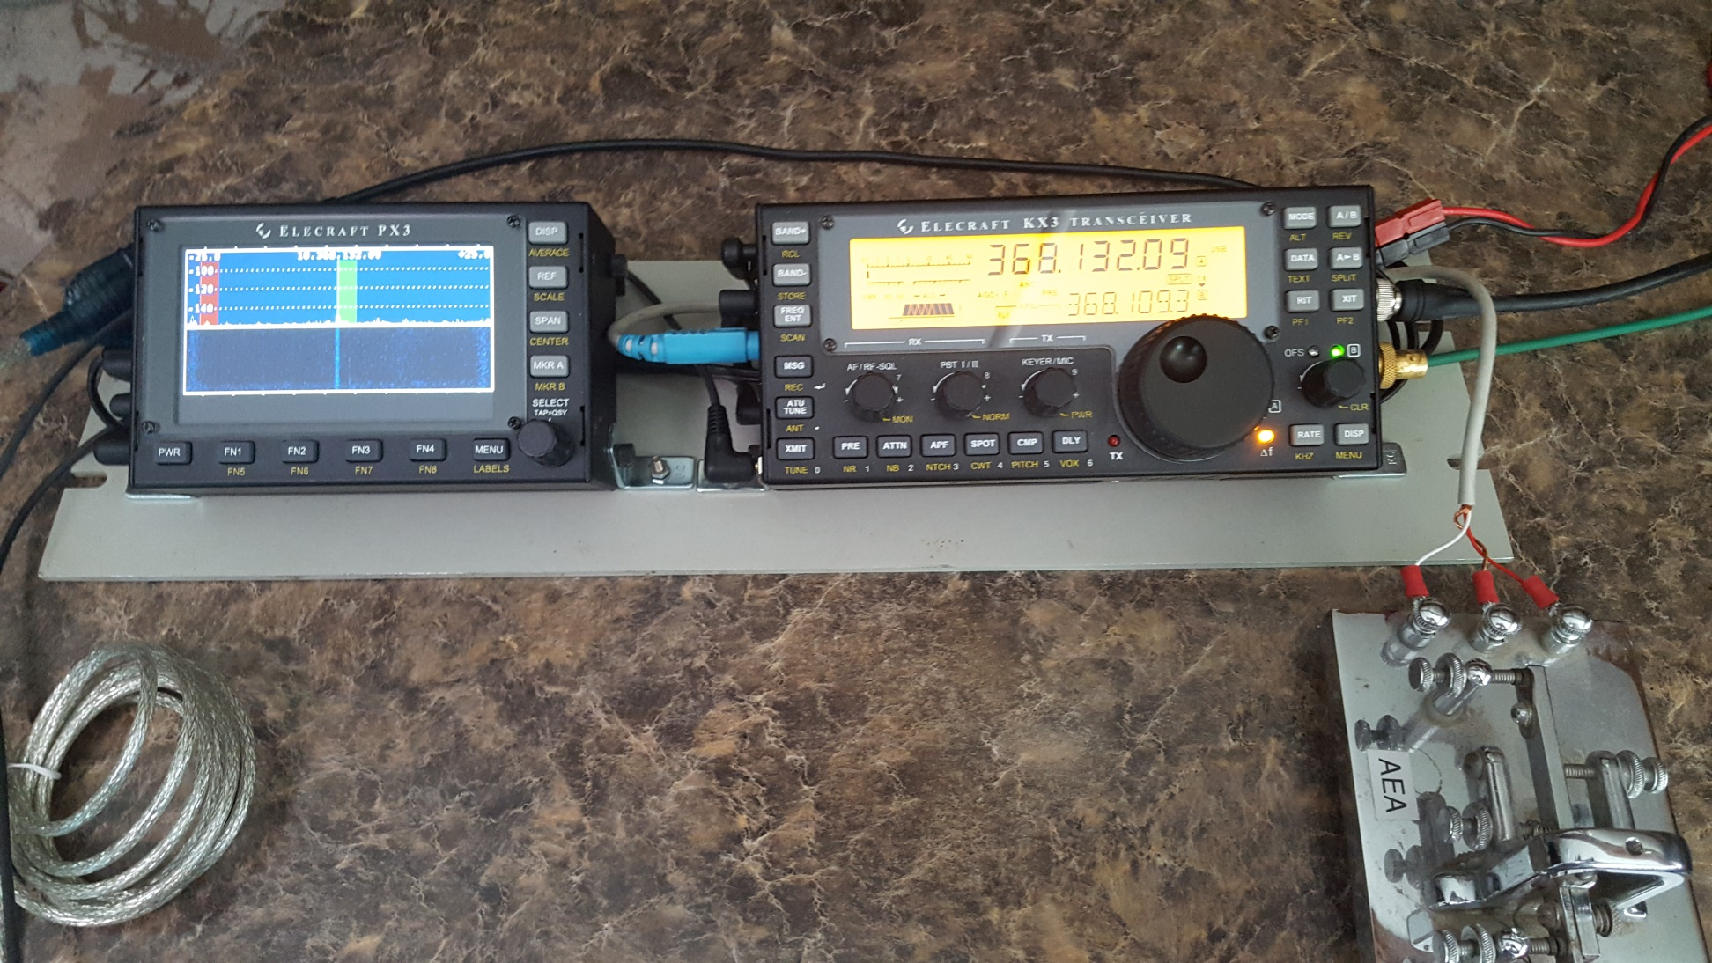
KX-3 & PX-3 as MW IF
Connections to Computer
Mic, rcve audio, and USB

Slide 6
Next Generation EME Setup
No matter what size dish one uses for EME, there are a couple of things that should always be considered.
Mounting the LNA at the feed is a major goal in building an EME station.
Generating the most power possible at the feed is also important.
I use TWTs at home in the shack but only so I can take advantage of having high power on both EME and tropo.
Since my 25 watt rover TWT decided to “let the smoke out”, I figured it was time to try some “SSPA” power…..

Slide 7
New LNA / SSPA Feed Assembly
Pin = +2dBm
Avantek
Discrete
Qorvo
+28dBm
+38 dBm
+47dBm (50w)
WR-75 Waveguide Relay
From DEMI XVTR
R
T
50 Ω Termination
T
R
Feeds DEMI 10 GHz XVTR ~ 4 dB NF
Feedhorn
LNA
<1 dB NF, 20 dB Gain

Slide 8
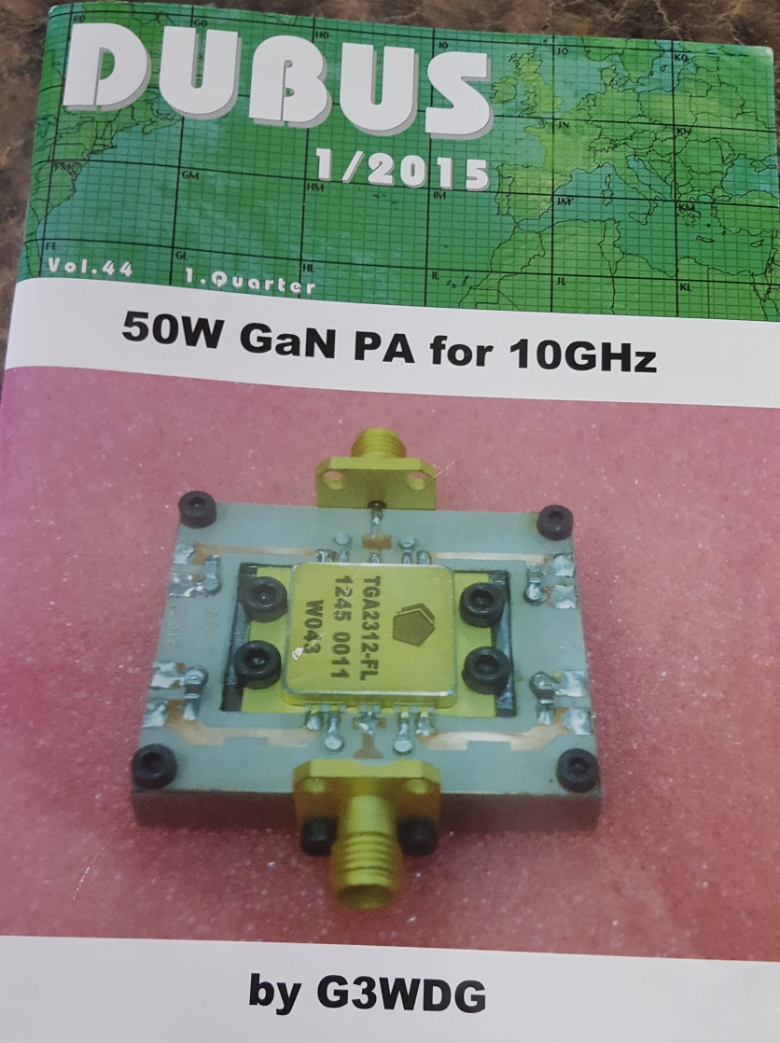
GaN Power
Triquent (Qorvo) has some rather nice but pricey parts for 10 GHz.
Charlie G3WDG did a nice write-up in DUBUS on a 50 w part for 10 GHz- I decided to give this part a try in the rover set-up

Slide 9
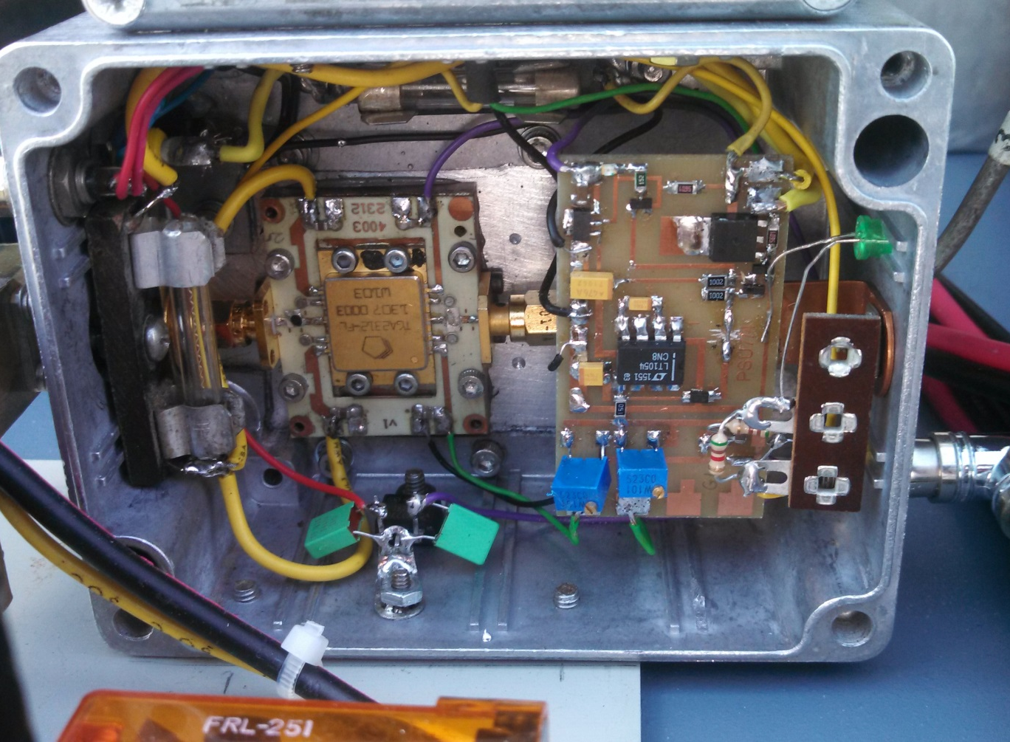
TGA2312-FL @ 10 GHz
TGA2312-FL
G3WDG Power Supply Board
50 watt device at 9 dB gain
Vdd = 24V
Idq ~ 2A
Id max = 4.5 to 5A
Device mounted to a copper or nickel plated aluminum block
G3WDG can help with the PCB
Cost $1050 from Mouser but compare at over $3500 for German made amplifiers

Slide 10
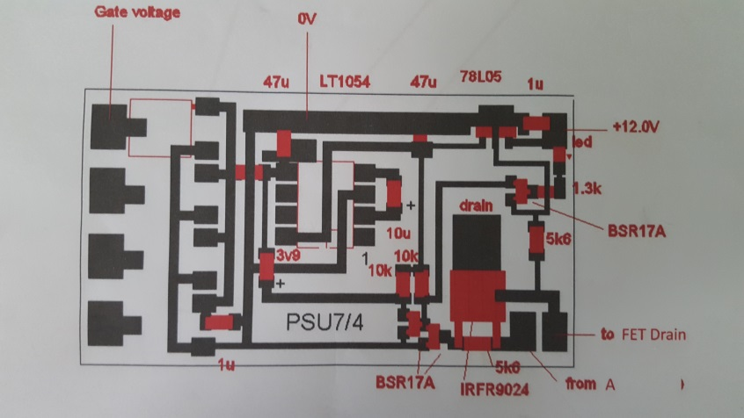
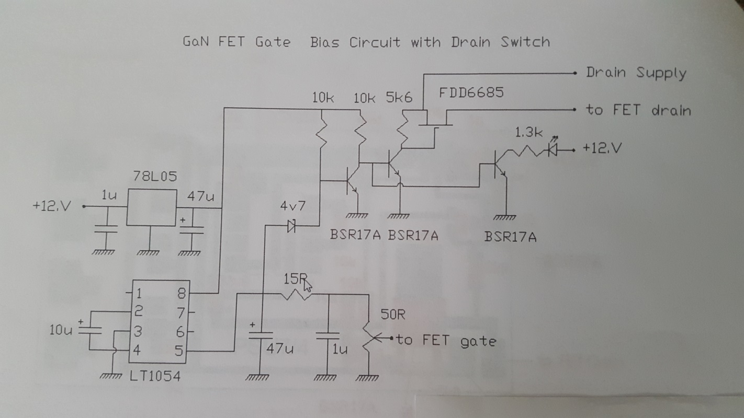
G3WDG FET Sequencer Board

Slide 11
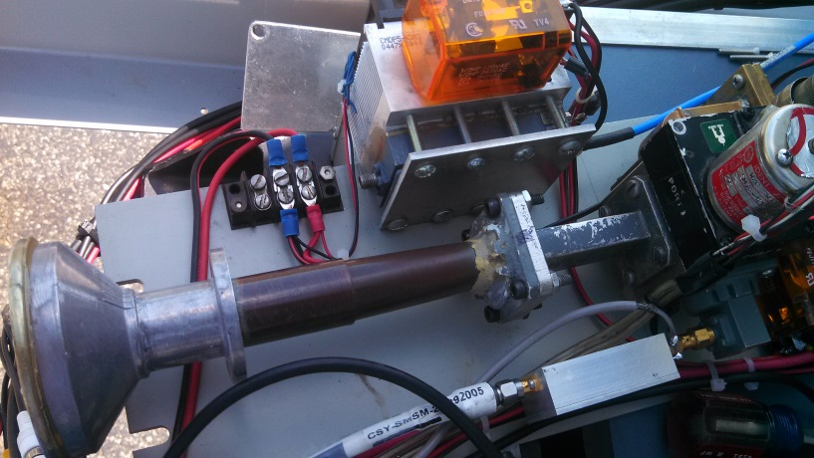
Surplus Corrugated Feed Horn
These are typically designed for 12 GHz
ID drilled out to .875 inch to accept the OD of standard .75 inch water pipe
.75 inch copper pipe can then be formed into WR-90 and then soldered to WR-90 flange

Slide 12
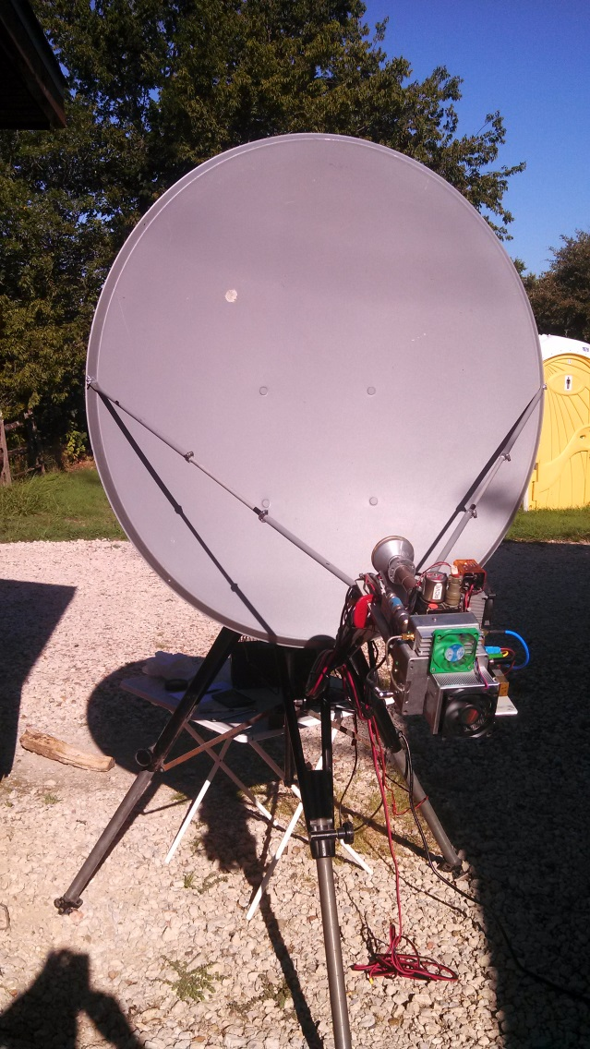
New Portable Set-Up
Heavy duty manual AZ-EL mount built by TerraCom that was originally used for portable point to point microwave link with a 4 ft fiberglass dish
Mounted a 1 m Winegard off set fed dish to mount
Gain ~ 37 to 38 dBi
3dB BW ~ 2.2 deg
First null at 2.8 deg
Extended and raised feed support arms to handle weight of new feed/wg relay/LNA/SSPS

Slide 13
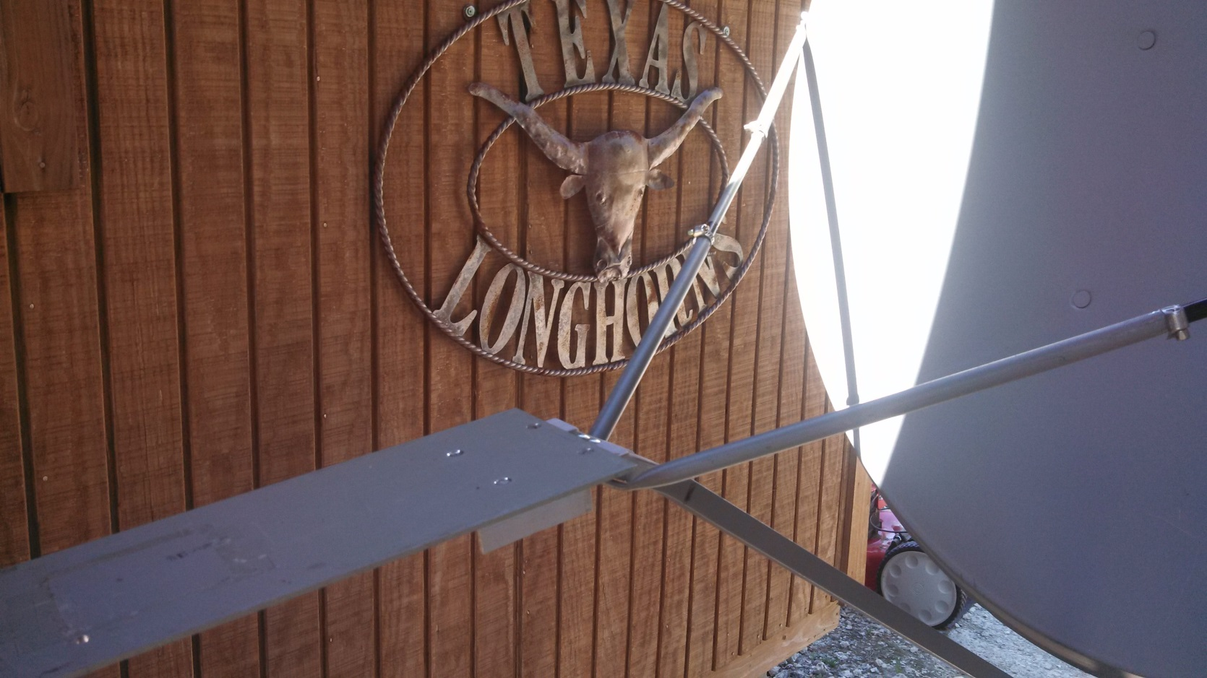
Improved Feed Platform & Relocation of Feed Support Arms

Slide 14
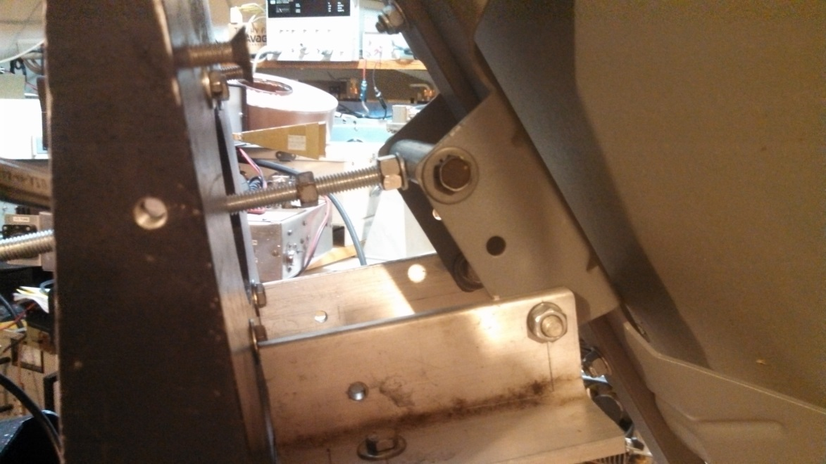
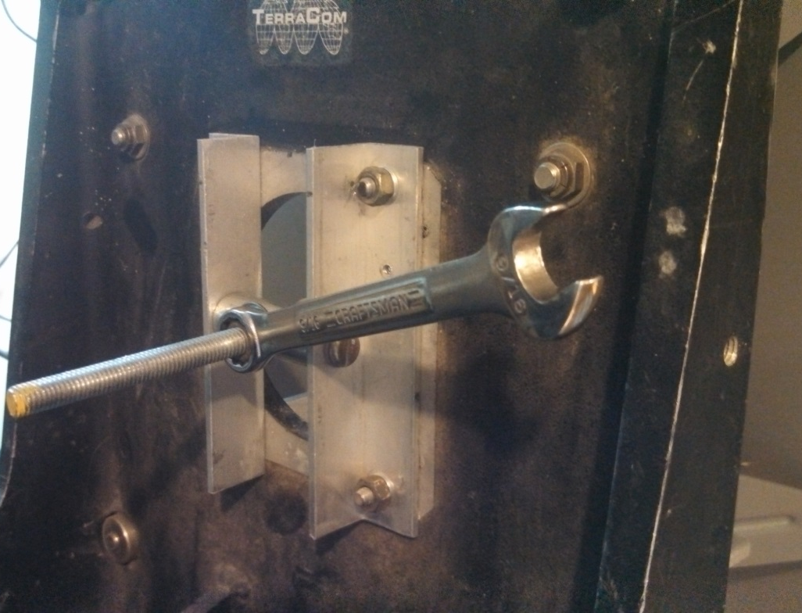
Manual EL over EL over AZ Portable Mount
The AZ-EL table provides Course El adjustment while the bolt arrangement shown here provides fine El adjustment
Plan to replace wrench with a small actuator

Slide 15
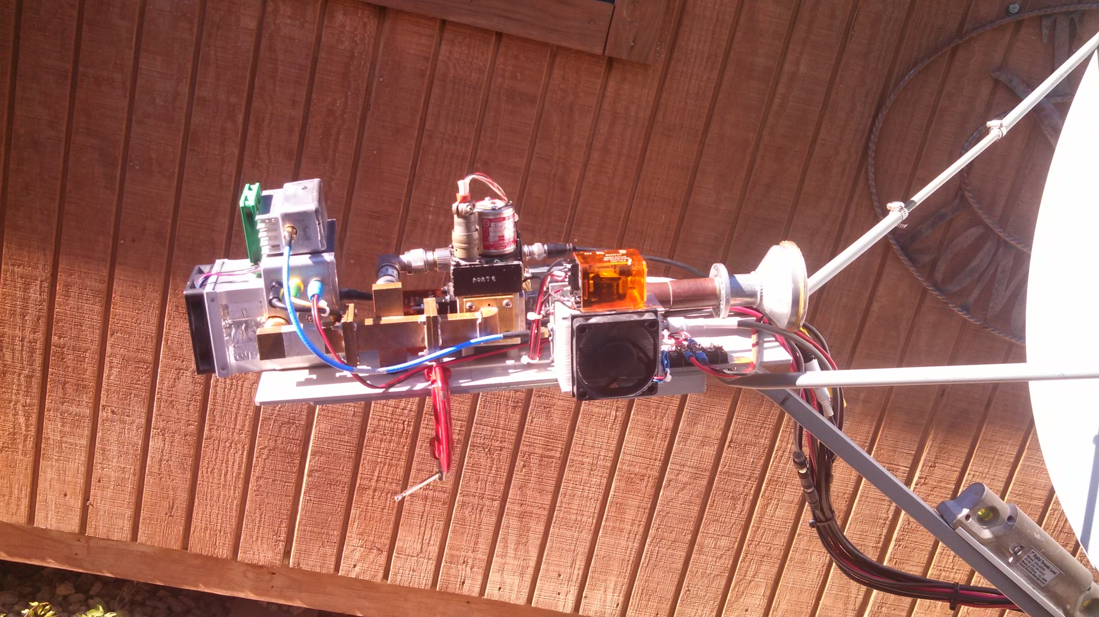
Feed/LNA/50W SSPA

Slide 16
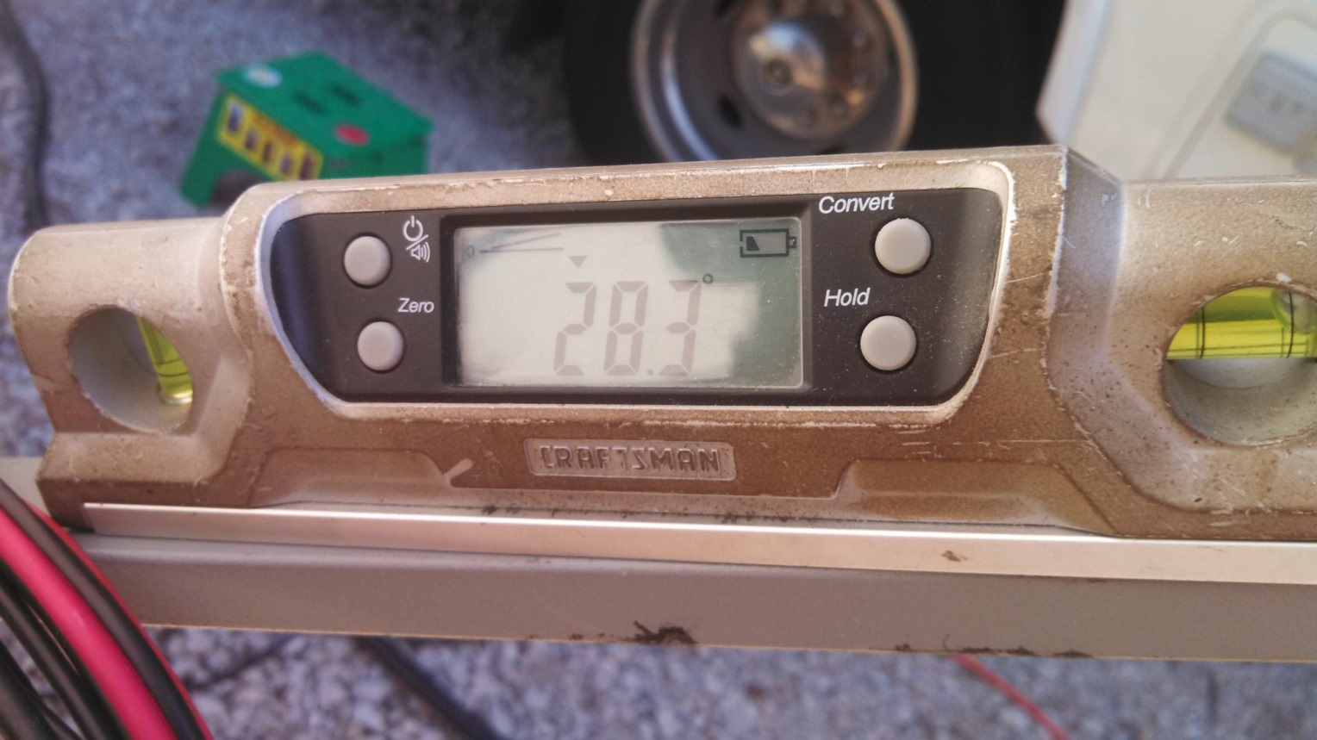
Sears Digital Level Used to Calibrate System Elevation
After calibrating elevation on “sun” noise, it was determined that the angle of the feed support arm was approximately 3 degrees below actual sun elevation on “my” offset fed dish – this value gets us close..

Slide 17
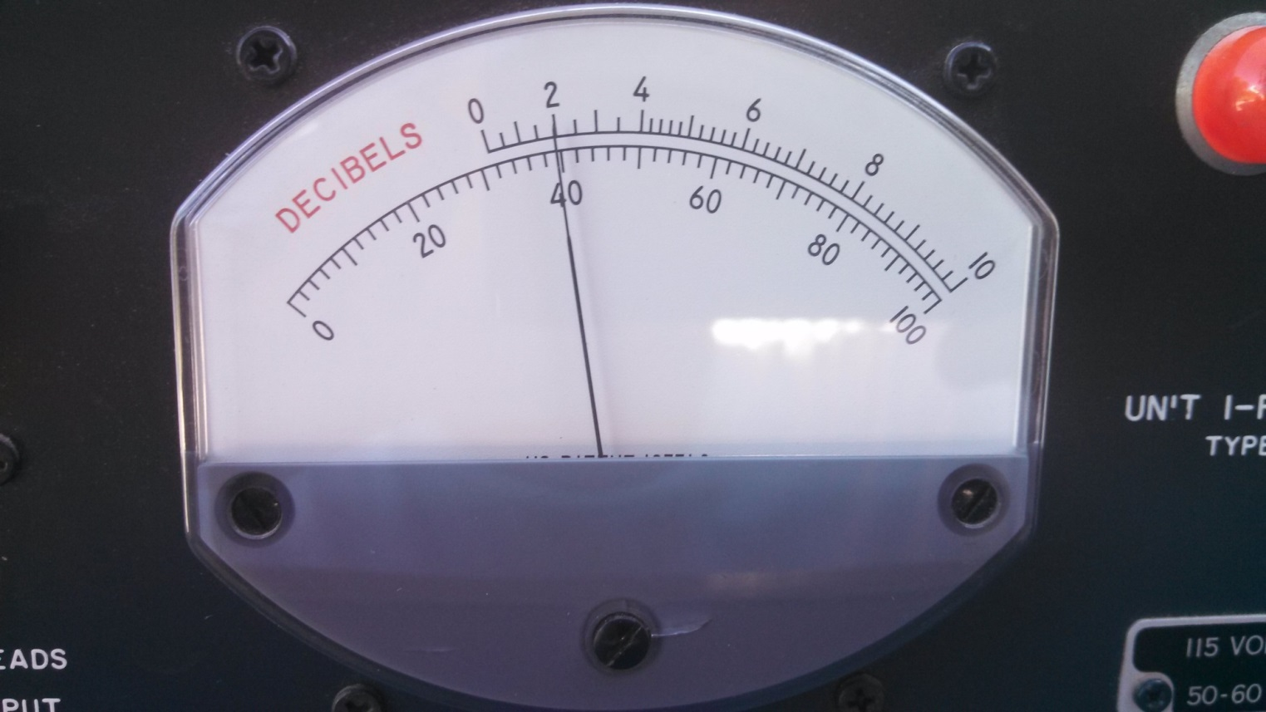
GR-1216 for Measuring Sun & Moon Noise
However, the only way (or the best way) to track the moon with a “field or portable setup” is by moon noise ……

Slide 18
DL0SHF 10GHz EME Beacon
10368.024 MHz
Your actual received frequency will be higher or lower based on your mutual doppler with grid JO54cg
7.2m dish and 50 watts
QRV when moon is above 10 degrees elevation in JO54cg
IDs CW and QRA-64D

Slide 19
Doppler from the Moon
Due to the relative rotation of the moon with respect to the earth, the doppler of a transmitted signal reflected from the moon on “moon rise” is at a maximum “positive” frequency offset.
Conversely on “moon set” the doppler is a minimum “negative” frequency offset.
When the moon is at zenith, the doppler is zero

Slide 20
Doppler Varies with Frequency
Doppler scales with frequency
Where maximum doppler may be .3 kHz at 144 MHz, the equivalent doppler at 10368 MHz will be 10368/144 = 72 X .3 kHz = 21.6 kHz at 10368 MHz
This is considered your self doppler…where your echoes will be based on your transmit frequency
And there is mutual doppler…where you will hear the other station based on your location and the other station’s location

Slide 21
Doppler Options – both stations must agree
First option – Call CQ and listen on my self doppler frequency, i.e 10368.121 MHz as an example…normal operation on 1296 and below
Second option when scheduling - listen on our mutual doppler frequency, i.e. 10368.100 MHz based on my location and the location of the station calling..more common when scheduling on 10 GHz CW
Third option – I do the mutual doppler correction on both receive and transmit for the other station…typically home station does this for a portable station
Fourth option but most desirable “out in the field” – I transmit and receive on prearranged frequency of 10368.050 MHz – works well if station calling us has capability to offset their transmit and receive frequency based on mutual doppler between his 6 digit grid square and our portable location
Fifth option – CFOM “Constant frequency on moon” – actually the best option if both stations are GPS frequency locked…..

Slide 22
Constant Frequency on Moon “CFOM”
Fifth option – Constant frequency on moon “CFOM” – actually the best option if both stations are TCXO or GPS frequency locked.
A station’s self doppler is the offset in frequency of your echoes relative to your transmit frequency. Self doppler is based on the relative position of the moon with respect to your location and is based on the total distance to the moon and back to earth.
As an example on 10 GHz, if your self doppler is +20 kHz then the doppler to the moon is only 20/2 = 10 kHz. This is the basis of CFOM.
Example…Pick a CFOM sked frequency of 10368.1 MHz. If half our self doppler is +10 kHz then we will transmit on 10368.090 MHz and listen on 10368.110 MHz
All stations that can see the moon and are using CFOM on 10368.1 MHz will appear on my radio at 10368.110 MHz…..plus as a bonus, I will always hear my echoes as well.

Slide 23
Constant Frequency on Moon “CFOM”
Requires precise frequency control for frequency accuracy and stability over time.
In my rover I use an ISOTEMP 10 MHz reference. Takes about 10 or 15 minutes to temperature stabilize and is generally within 200 Hz at 10 GHz which is more than adequate. Stability is very good over time.
At home I use an HP Z3801A with 10 MHz output.
As a second 10 MHz reference, I use a Trimble GPS receiver with a small remote antenna mounted on the window of the shack window.
Most important. The signal must fall within the passband of the WSJT waterfall The signal must be constant in frequency over the length of a transmission. Otherwise decoding will be difficult.

Slide 24
Precise Timing is Required
Dimension 4 works great if an internet connection is available.
For remote / rover operations consider the Microsoft 360 USB GPS timing piece and IZ1BKT’s program bkttimesync. The latest version will keep correct time with an internet connection, GPS connection or with an I phone.
http://www.maniaradio.it/en/bkttimesync.html

Slide 25
K5GW DOS Tracking Program

Slide 26
F1EHN EME System V7.0

Slide 27
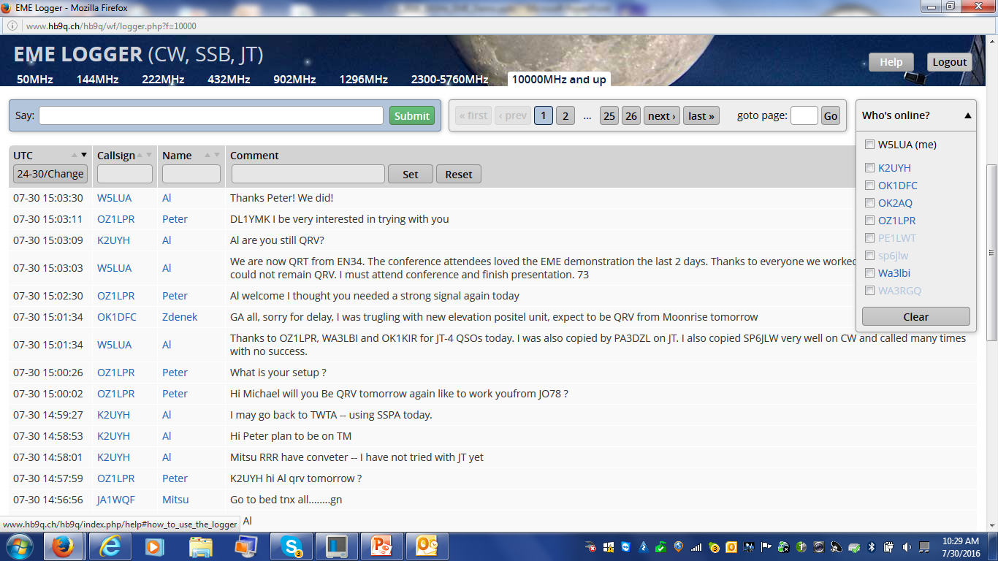
HB9Q Logger

Slide 28
Results in Rochester, MN in July 2016
8 QSOS on JT-4F
Worked OZ1LPR, HB9Q, G3WDG, OK1KIR, WA3LBI
Heard and called SP6JLW on CW with no success. SP6JLW was armchair copy most of the time calling CQ
Now on to results at MUD in St. Louis….

Slide 29
Microwave Update Conference St. Louis, MO October 13 & 14, 2016

Slide 30
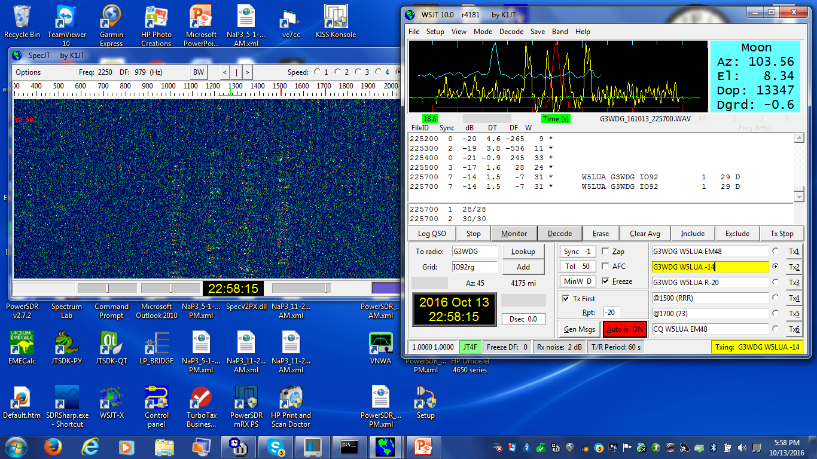
G3WDG at 2257Z

Slide 31
OZ1LPR at 2305Z

Slide 32
OK1KIR at 0033Z

Slide 33
K5GW QSO

Slide 34
Big surprise – G4CBW called us!

Slide 35
Screen at G4CBW – 1.5m dish/75W

Slide 36
Results in EM48ss
8 QSOs on JT-4F
Worked G3WDG twice, OZ1LPR, OK1KIR, WA3LBI, K5GW, G4CBW, and OK1CA
Highlight was working G4CBW who was running a 1.5 m dish and 75 watts

Slide 37
VK7MO Operating Location at QH19, the most Northerly Grid locator on the Australian mainland
1.13m Prime Focus Dish and 90 watts SS

Slide 38
Grids activated over the last few years on 3 cm EME by Rex VK7MO
OK1KIR’s grid map showing the grids they worked Rex in
The high lighted grids are on Rex’s recent grid run in 2018

Slide 39
QRA-64D QSO with VK7MO QH24fk
Stations start QSO by sending 1000 Hz tone in WSJT and view received signal in waterfall

Slide 40
QRA-64D QSO with VK7MO QH24fk
When one station, usually dx station, is content with signal strength, he sends 1250 Hz indicating it is time to send messages

Slide 41
QRA-64D QSO with VK7MO QH24fk
The QSO is completed in a short amount of time

Slide 42
Random QRA-64D QSO with VK7MO QH17hu
No internet required
Just time and frequency
with CFOM mode

Slide 43
WSJT1.9.1

Slide 44
“Full Doppler to DX Grid”
Sets your receive and transmit frequencies based on the mutual doppler between your 6 digit grid square and the 6 digit grid square of the station that you are attempting to work.
This allows the other station to merely set their receive and transmit frequency on the “sked frequency” and operate transceive and you do all the “hard lifting” with doppler. This mode only works between you and the station that you are scheduling.

Slide 45
“Own Echo”
Sets your transmit frequency on the “sked frequency” and sets your receive frequency to your echo or self doppler frequency.
Useful for hearing your echoes at your location only.

Slide 46
“Constant Frequency on Moon”
Sets your receive and transmit frequencies such that the “man on the moon” would be able to communicate with you on the sked frequency with you living on earth. In effect the frequency offset is half your self doppler frequency.
This allows you to hear your own echoes all the time and also any station that is calling you on EME using CFOM on the sked frequency.
This is the preferred mode!

Slide 47
“On DX Echo”
DX station announces their transmit frequency. You want to be on their echo frequency. Even if they are a small station, they know where to tune for their echo. So you want to position your transmit frequency such that you will appear on their echo frequency. This mode will provide the correct transmit and receive frequencies for you to hear the DX station and you to be heard by the DX station.

Slide 48
WSJT “Call DX”
Adjusts your transmit frequency to put your echo on your received frequency.
Useful for hearing your echoes and putting your echoes on the frequency of the station that you are listening to and trying to work.

Slide 49
Now that you are confused..
If you are confident of your frequency and your location with a 6 digit gridsquare by being GPS locked but lack the ability to do any mutual doppler frequency correction then..
Request the following of the station you are attempting to work.
Have the station you are trying to work do the full mutual doppler frequency correction on your desired sked frequency. This is the “Full Doppler to DX Grid” mode. This allows you to run transceive on the sked frequency.

Slide 50
What if you decide to call CQ on a particular frequency?
Stations you are trying to work will need to know your 6 digit grid square to calculate where they will receive you on their radio dial and where they need to transmit based on mutual doppler between their grid square and your grid square.
Stations using WSJT will use the “Full Doppler to DX Grid” mode to find you and call you. This method involves the use of mutual doppler based on their 6 digit grid square and your 6 digit grid square.

Slide 51
Summary
Although the frequency aspect may sound intimidating don’t be alarmed.
If you are peaked on moon noise and are within a couple hundred Hz on frequency at 10 GHz and you are within a second or two on time…..you will be successful.
I will be glad to try with you on 10 GHz EME…I have a 5 meter dish and 250 watts in the shack.

Slide 52
Thanks for Listening!
Any questions?
pdf will be up on www.ntms.org
My email is w5lua@sbcglobal.net
73 and see you on the moon!

